Slide 1


Kisan-DSS (Decision Support System)
Empowering farmers to take Right Decisions
Kisan DSS empowers farmers with data-driven, multilingual decision support.
Presented By:
Onkar Waghmode
Aditya Zite
Kisan DSS

Slide 2




Kisan DSS: Solving Real Farmer Challenges
Indian farmers face critical decisions at every stage of the crop cycle. From selecting the right crop to selling at fair prices, they often lack the data and insights needed to maximize yields and profits. Kisan DSS bridges this gap with AI-powered, data-driven guidance.
The Challenge Across the Crop Cycle
Sowing
Farmers lack localized soil data, weather forecasts, and profitability analysis to select the best crop for their land and market conditions.
Cultivation
Without proper guidance, farmers misuse pesticides and fertilizers, damaging soil health and reducing yields while increasing costs unnecessarily.
Harvesting
Poor rainfall predictions and lack of weather insights lead to wrong timing, crop loss, and missed opportunities for optimal harvest quality.
Selling
Limited market data access forces farmers to depend on middlemen, losing 30-40% of profits to intermediaries and price manipulation.

Slide 3
The Farming Journey – Solution Offered
Kisan DSS guides farmers through every stage of production with AI-driven insights designed to maximize profits and minimize risk.
Sowing
Harvesting
Smart crop selection
Optimal timing
1
2
3
4
Cultivation
Selling
Weather Advisory & actionable farming advice
Guided practices & Government Schemes
Maximum returns

Slide 4
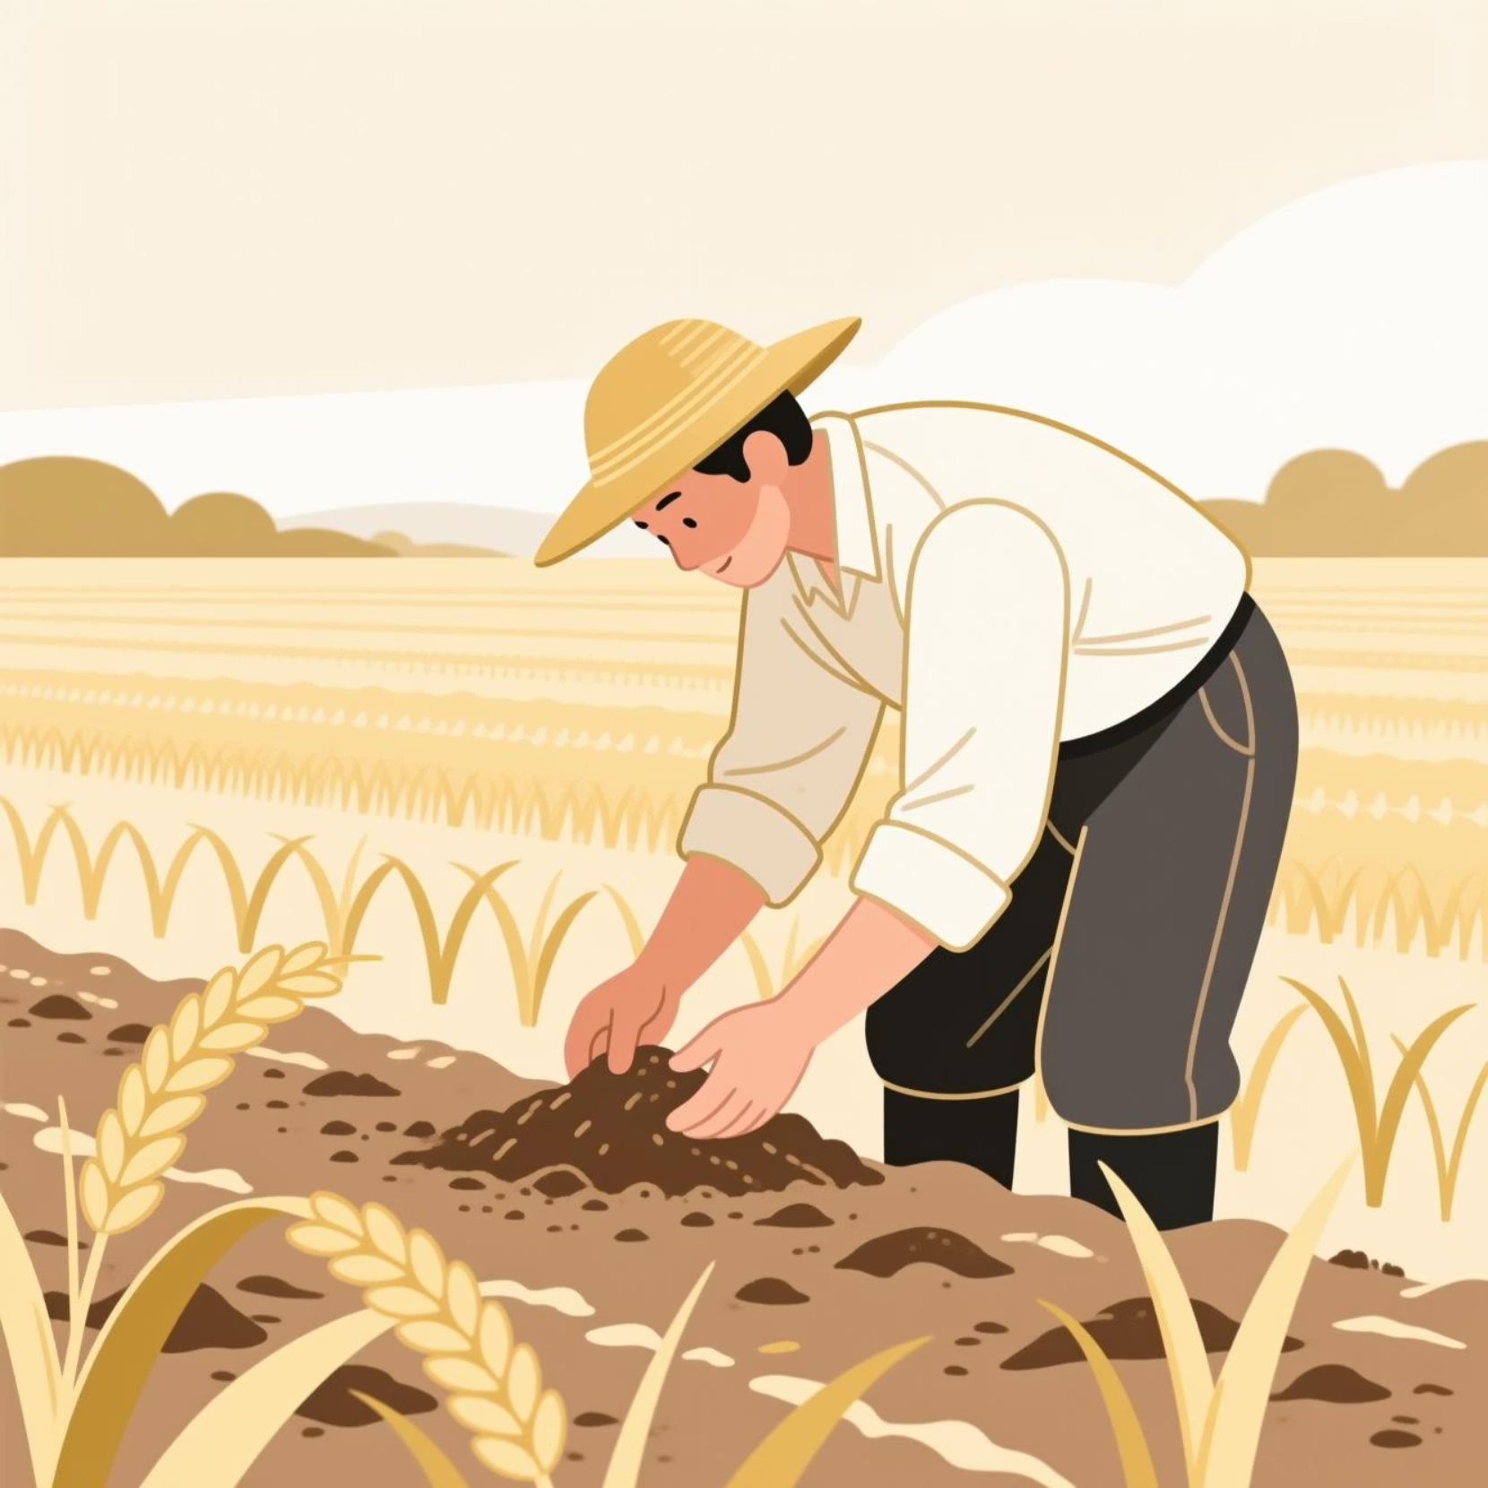
Sowing Stage: Smart Crop Selection
Data-Driven Recommendations
Meteorological analysis: Temperature, rainfall, humidity patterns for your location
Environmental factors: Soil quality, water availability, local climate zones
Profitability prediction: Expected market demand and crop prices
The system analyzes all factors to recommend the most profitable crop suited to your farm's unique conditions.

Slide 5

Cultivation: Expert Guidance at Every Step
Government Schemes
Best Practices
Curated agricultural videos and expert guidance on proven cultivation techniques.
Automatic identification of subsidies and support programs you qualify for.
Weather Smart Farming
Smart, location-based weather advisory system that provides actionable guidance for farmers based on real-time weather forecasts.

Slide 6
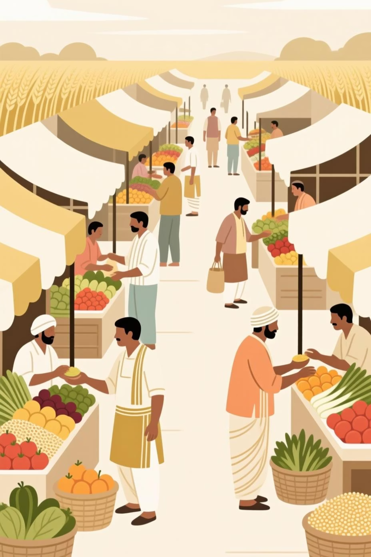
Selling: Maximum Profit Through Market Intelligence
Our Smart Decision-Building Engine evaluates market prices, transportation costs, and your storage capacity to recommend the most profitable selling option.
Market Analysis
Cost-Benefit Comparison
Compare prices across multiple mandis to find the best rates for your produce.
Transportation costs are calculated to show true profit margins.
Local Markets
Optimal Harvest Timing
Market price trends and weather forecasts combined to identify the ideal harvest window—minimizing losses from weather damage or price drops.
Get the optimal local market based price in market and transportation cost.

Slide 7
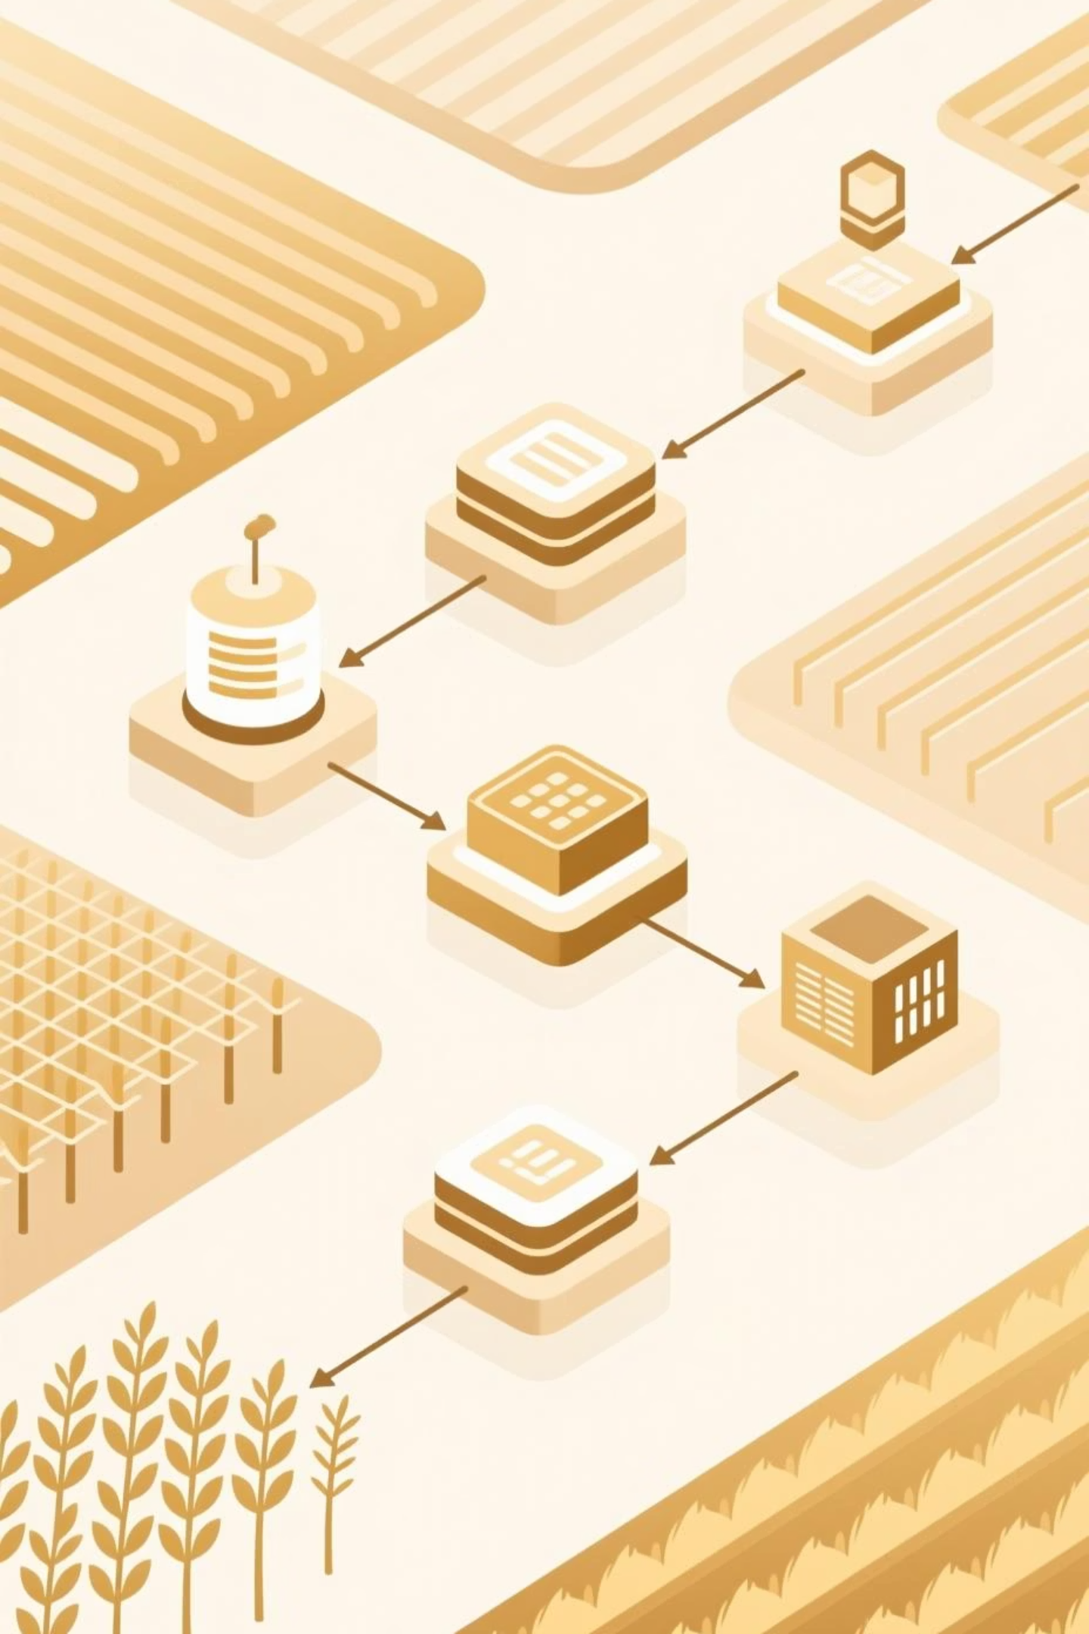

Kisan DSS Methodology
An integrated AI pipeline transforming agricultural data into actionable farmer insights
Preprocess & Analyze
Data & Integration
AI Predictive Models
Decisions & Feedback

Slide 8
How Kisan DSS Works for Farmers
A seamless journey from raw data to intelligent recommendations, designed specifically for smallholder farmers
01
02
Data Collection – Agmarket, data.gov.in
Data Processing – Row data to Processed data
Real-time aggregation of weather patterns, soil conditions, government schemes, and market prices from trusted APIs and official sources
Advanced cleaning and normalization ensures data quality and consistency for accurate analysis and reliable machine learning training
03
04
AI Analysis – Random Forest
Smart Recommendations – ML Models + Gemini API
Machine learning models predict crop profitability, forecast price trends, and identify optimal farming decisions based on local conditions
Personalized guidance on when to sow, how to cultivate, optimal harvest timing, and best selling strategies for maximum returns
05
06
Voice-Enabled Access – Web Speech API
APIs Integration – OSRM, Daily Fuel Price, Open Weather Map , Gemini API
Multilingual voice chatbot delivers recommendations directly to farmers in their preferred language, bridging the digital divide
Feedback loops and real-world outcomes refine model accuracy.

Slide 9













Kisan DSS Tech Stack
Complete technology architecture powering AI-driven agricultural decision support for farmers across India.
AI & Machine Learning
Database & Storage
Python, Scikit-learn, Pandas, NumPy for predictive analytics and data processing.
MongoDB for flexible, scalable data management and document-based architecture.
Backend & APIs
Frontend & UI
Flask/FastAPI enabling weather, soil data, market prices, and government scheme integrations.
React.js delivering responsive, intuitive interfaces for farmers and stakeholders.
Multilingual Support
AI Chatbot
Web Speech API enabling voice interaction in regional languages.
Gemini API with Retrieval-Augmented Generation pipeline for context-aware farmer guidance.
Data Integration
Intelligent Automation
Real-time weather, soil composition, market rates, and government schemes centralized for actionable insights.
Machine learning models analyze regional patterns and crop-specific recommendations with voice accessibility.

Slide 10






What Makes Kisan DSS Different
Kisan DSS transforms farming with AI-powered guidance across every stage—from sowing to selling. Unlike traditional advisory platforms, we integrate weather, soil, market, and government data to maximize your profit while keeping decisions simple and accessible.
Full-Cycle Support
Profit Prediction
Your Language, Your Voice
Expert guidance for sowing, cultivation, harvesting, and selling—all in one platform.
AI analyzes market trends and crop profitability to help you make decisions that boost your income.
Multilingual, voice-enabled chatbot works in Indian languages so you can interact naturally.
Unified Data Ecosystem
Smart Selling Strategy
Weather forecasts, market prices, and government schemes—all connected and analyzed together.
AI engine calculates optimal timing, pricing, and logistics to maximize profit when you sell.
The bottom line: Kisan DSS puts AI expertise in your hands—helping you grow smarter, sell better, and earn more.

Slide 11


Special Recognition
Kisan DSS – AI-Powered Decision Support System for Farmers has earned distinction through competitive recognition and peer-reviewed scholarship, validating its innovation and impact.
Agritech Excellence Award
Peer-Reviewed Publication
Recognized as Best Solution in Agritech at the national-level Innovate You Techathon 2.0, organized by the Innovation Foundation. This competitive recognition highlights our system's innovation and practical impact on agricultural decision-making.
Research paper published and indexed in Communications on Applied Nonlinear Analysis, a Scopus-ranked journal. This scholarly achievement demonstrates the scientific rigor and technical depth underlying Kisan DSS's algorithmic framework.

Slide 12

THANK YOU

